Slide 1
SALES MANAGEMENT SYSTEM
Submitted by: Swathi Vimala
Course: Data Analyst / SQL
Year: 2026

Slide 2
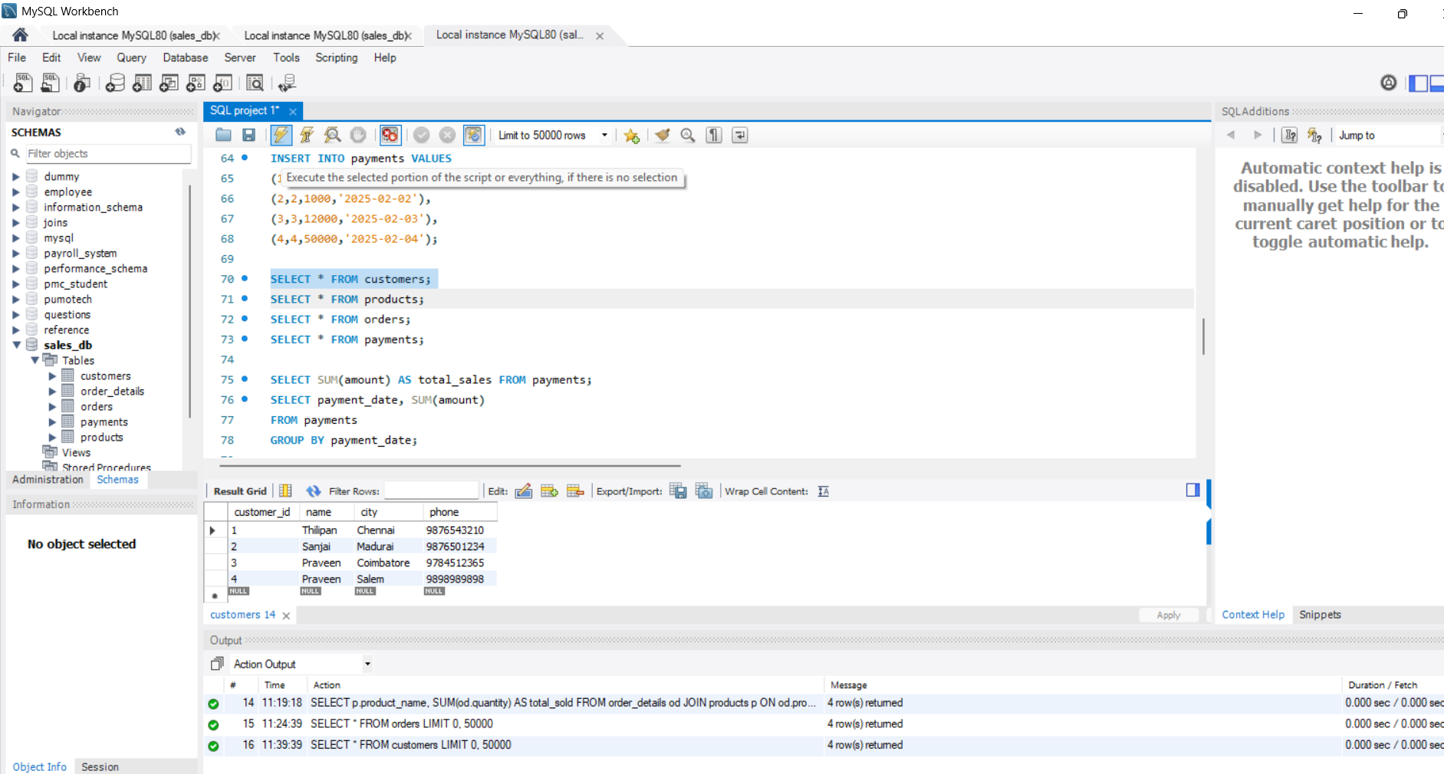
Customers Data
SELECT * FROM customers;

Slide 3
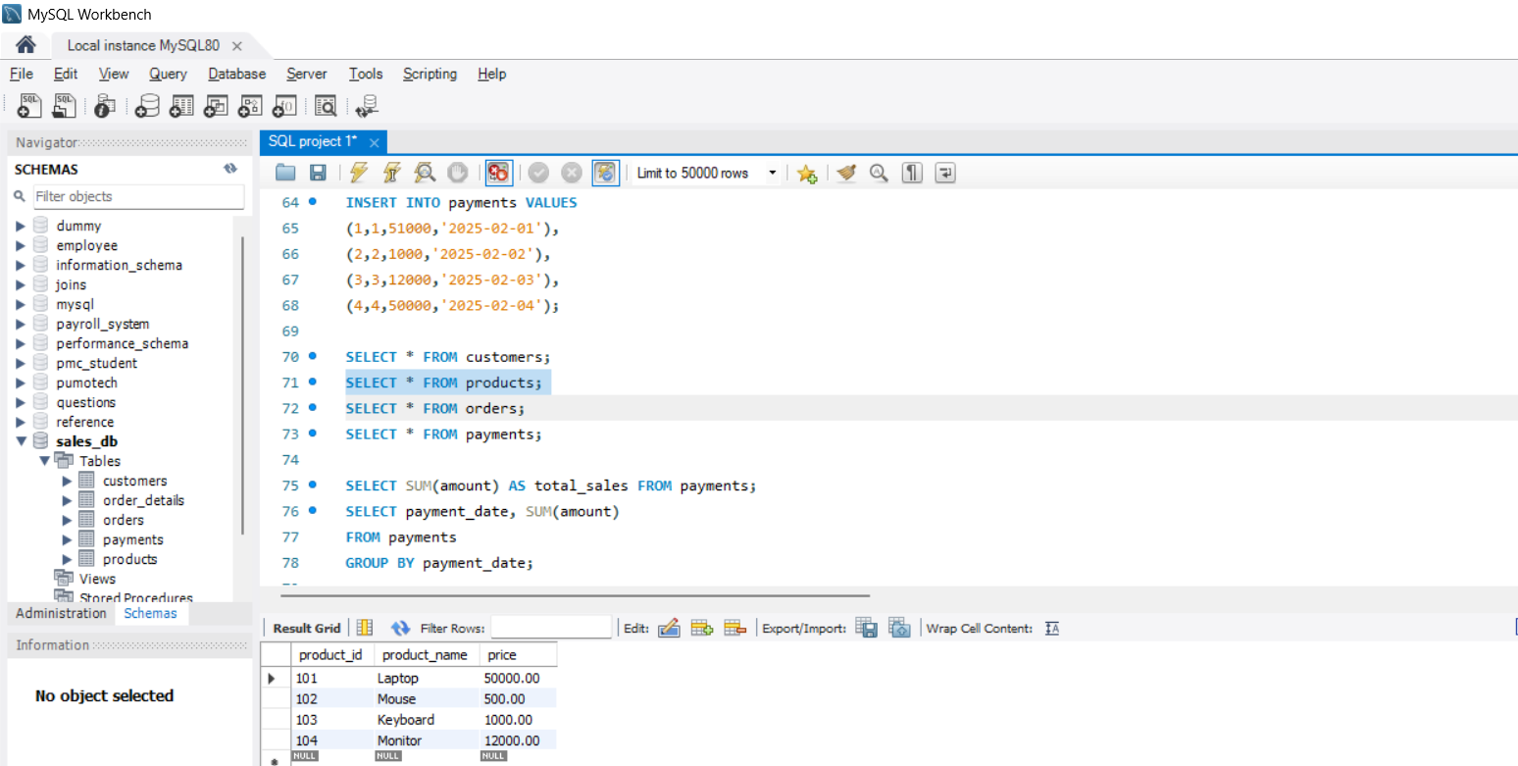
Products List
  SELECT * FROM products;

Slide 4
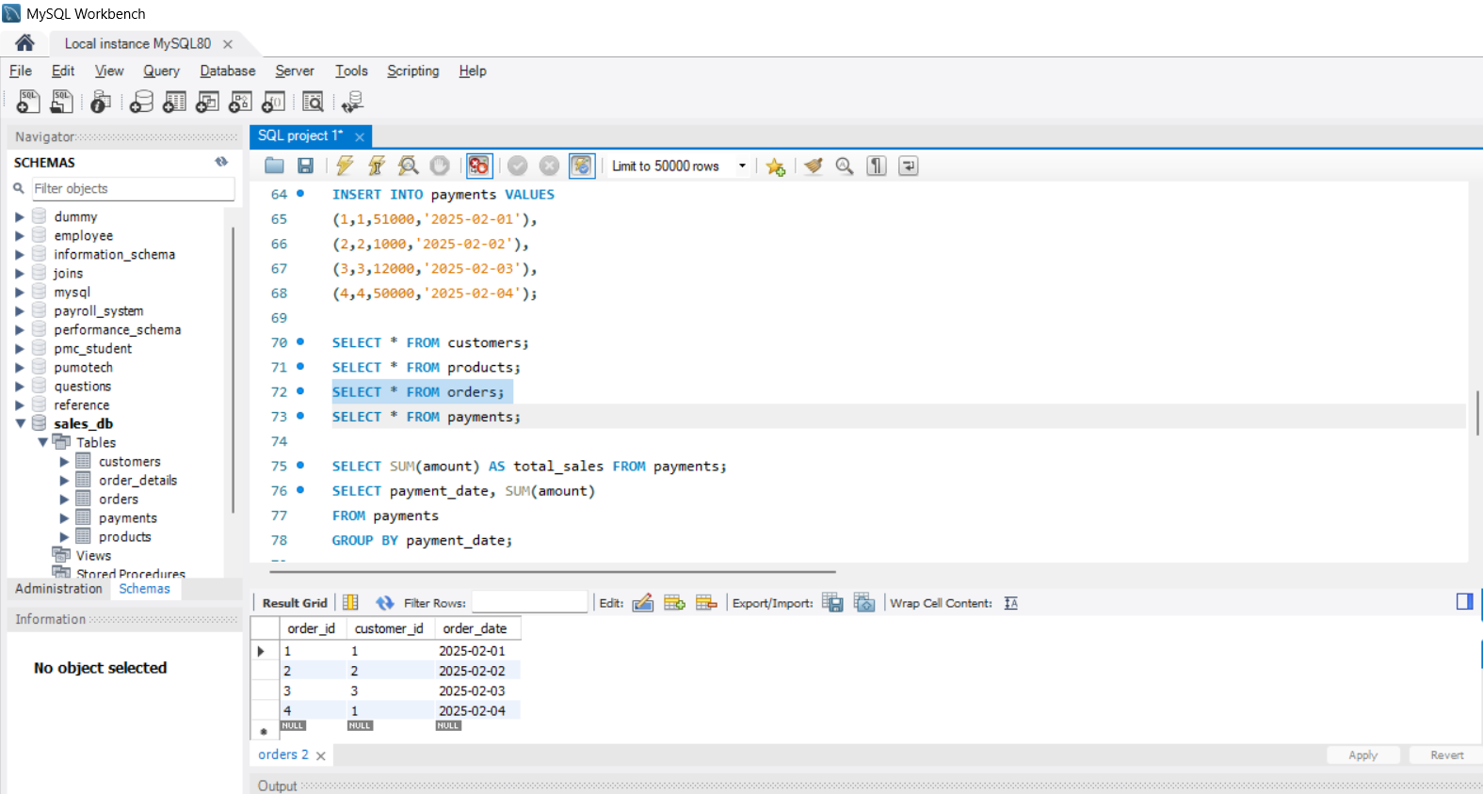
Orders Table
SELECT * FROM orders;

Slide 5
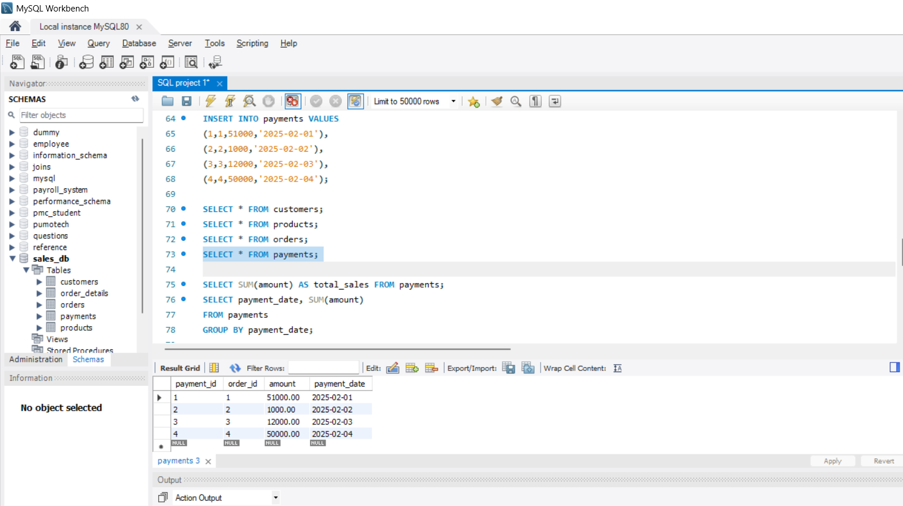
Payments Details
SELECT * FROM payments;

Slide 6
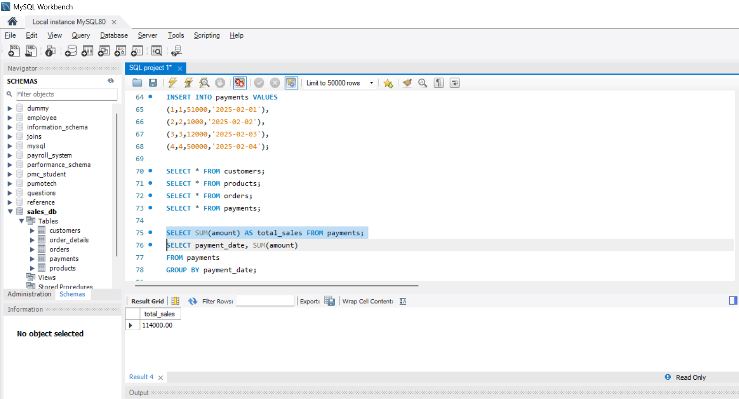
Total Sales
SELECT SUM(amount) AS total_sales FROM payments;

Slide 7
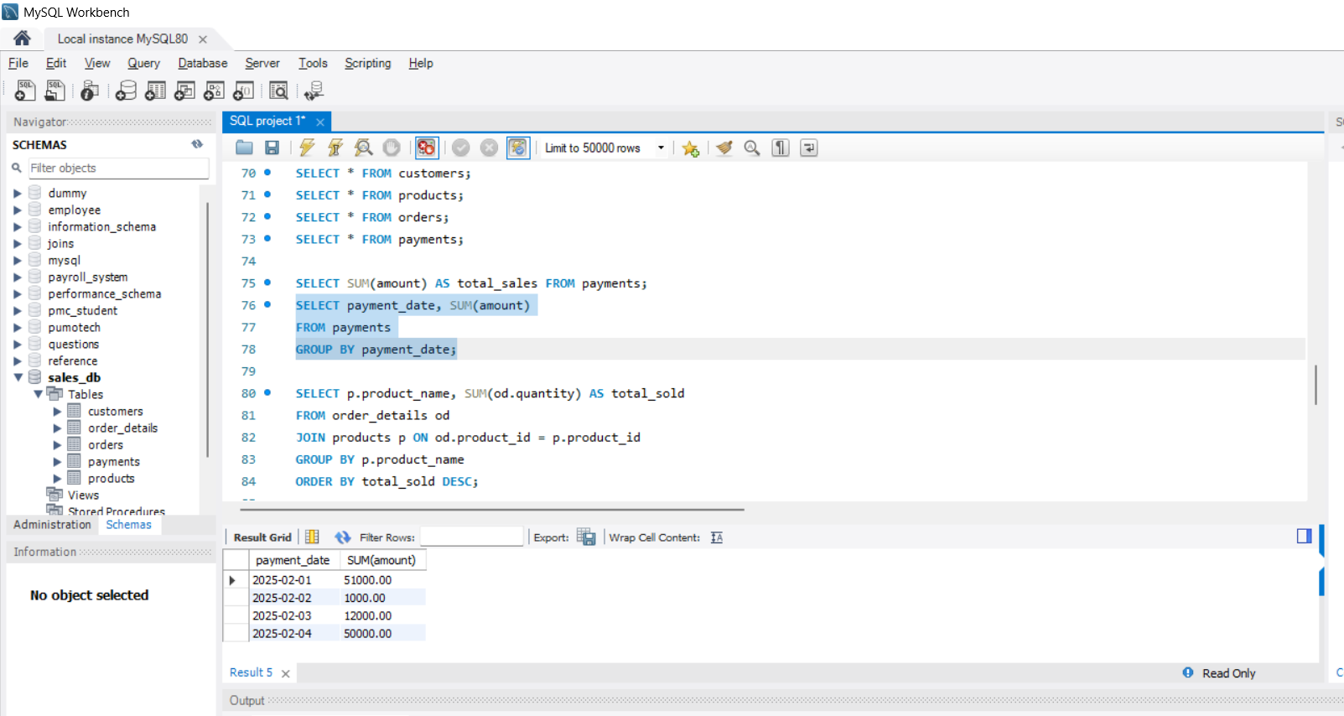
Daily Sales
SELECT payment_date, SUM(amount) AS daily_sales
FROM payments
GROUP BY payment_date;

Slide 8
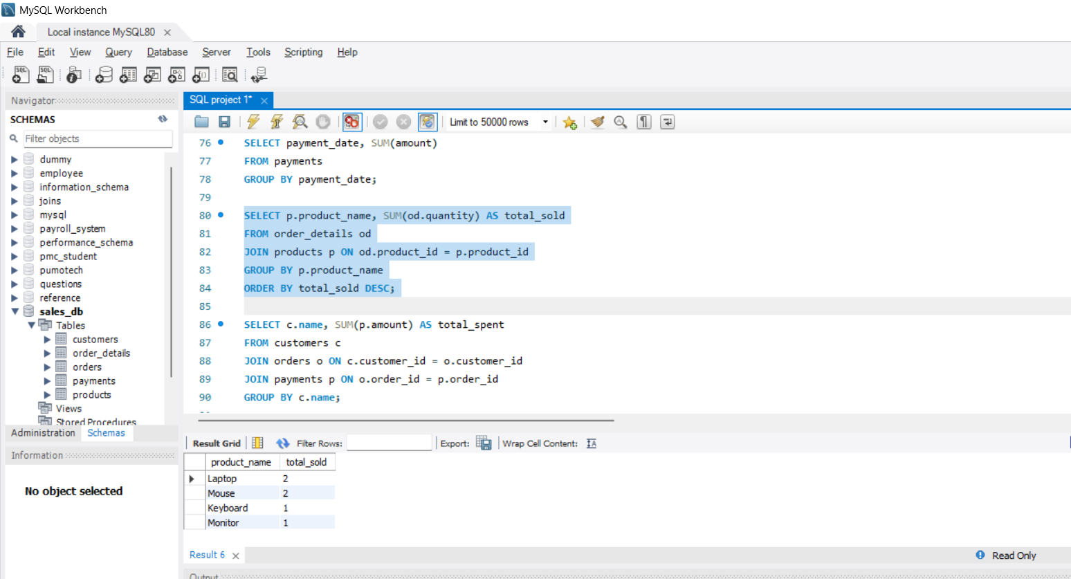
Best Selling Products
SELECT p.product_name, SUM(od.quantity) AS total_sold
FROM order_details od
JOIN products p ON od.product_id = p.product_id
GROUP BY p.product_name
ORDER BY total_sold DESC;

Slide 9
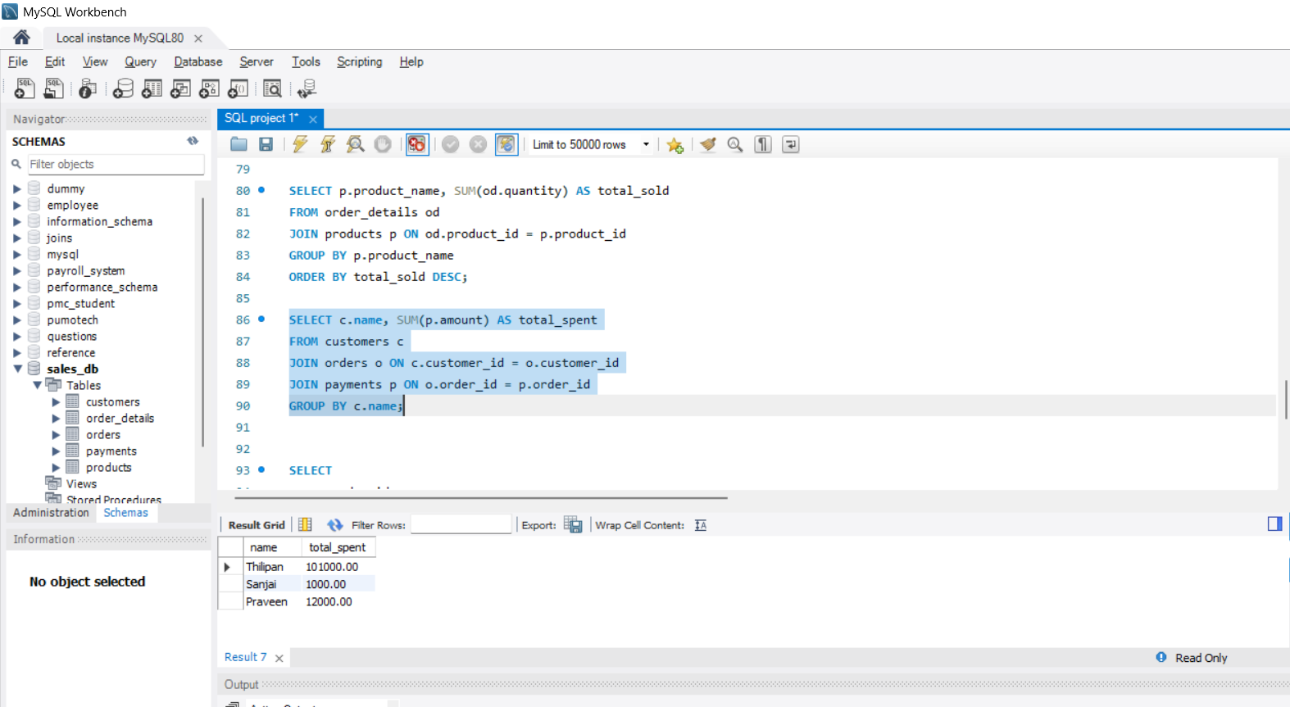
Customer Wise Sales
SELECT c.name, SUM(p.amount) AS total_spent
FROM customers c
JOIN orders o ON c.customer_id = o.customer_id
JOIN payments p ON o.order_id = p.order_id
GROUP BY c.name;

Slide 10
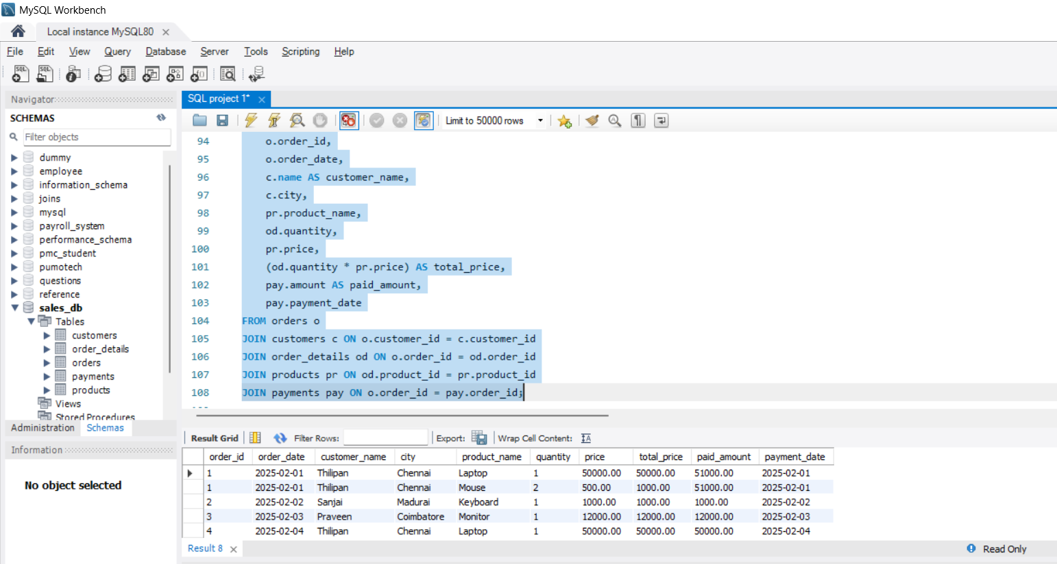
Order Full Details
SELECT
o.order_id,
o.order_date,
c.name AS customer_name,
c.city,
pr.product_name,
od.quantity,
pr.price,
(od.quantity * pr.price) AS total_price
FROM orders o
JOIN customers c ON o.customer_id = c.customer_id
JOIN order_details od ON o.order_id = od.order_id
JOIN products pr ON od.product_id = pr.product_id;

